Slide 1
SPI Protocol
What is SPI…?
The Serial Peripheral Interface (SPI) is a synchronous full duplex serial communication interface specification used for short-distance communication, primarily in embedded systems like interface between microcontroller and peripheral IC’s such as sensors, ADCs, DACs, shift registers, SRAM, and EEPROM etc..

Slide 2
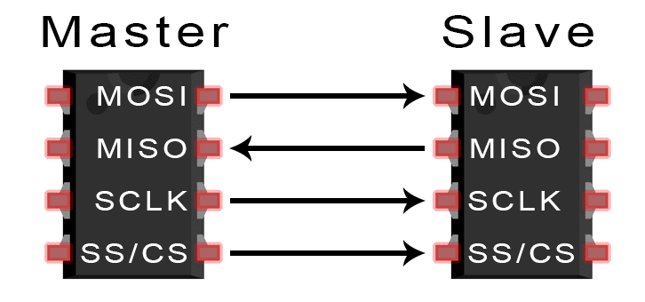
Wiring connection in SPI
Basics of the SPI Communication Protocol (circuitbasics.com)
MOSI (Master Output/Slave Input) – Line for the master to send data to the slave.
MISO (Master Input/Slave Output) – Line for the slave to send data to the master.
SCLK (Clock) – Line for the clock signal.
SS/CS (Slave Select/Chip Select) – Line for the master to select which slave to be selected to send data.

Slide 3
Why SPI…?
No start and stop bits, so the data can be streamed continuously without interruption.
No complicated slave addressing system like I2C.
Higher data transfer rate than I2C (Upto 10Mbps).
Separate MISO and MOSI lines, so data can be sent and received at the same time.

Slide 4
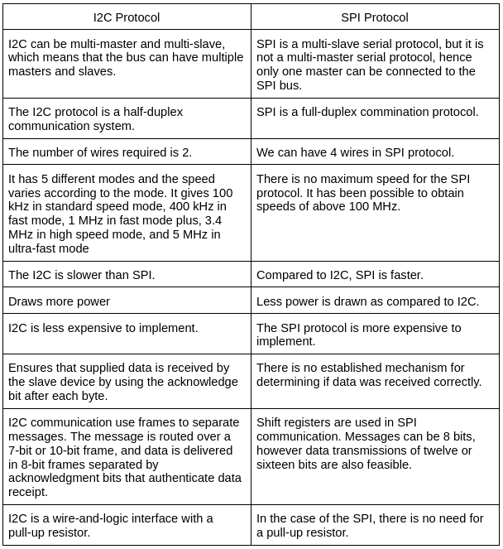
Difference between I2C and SPI

Slide 5
SPI working
Master
Slave

Slide 6
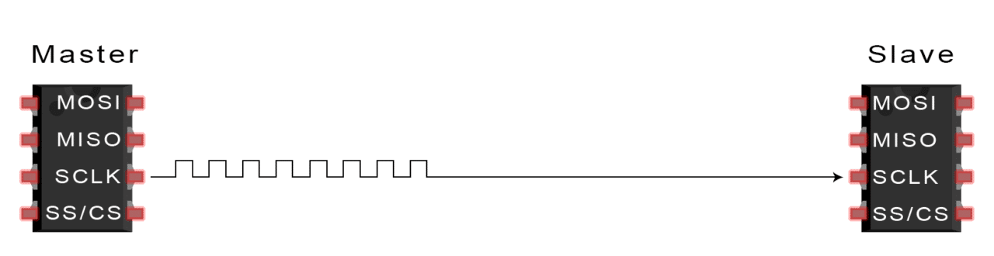
1) The master outputs the clock signal

Slide 7
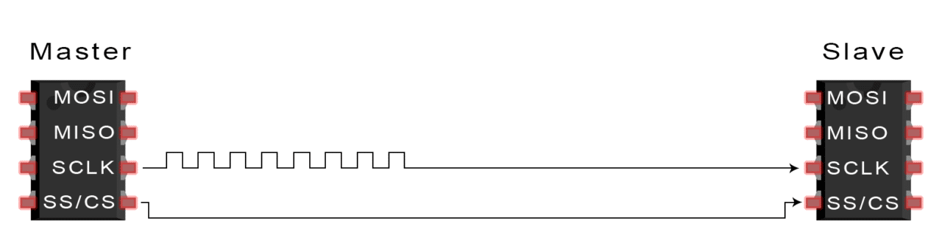
2) The master switches the SS/CS pin to a low voltage state, which activates the slave

Slide 8
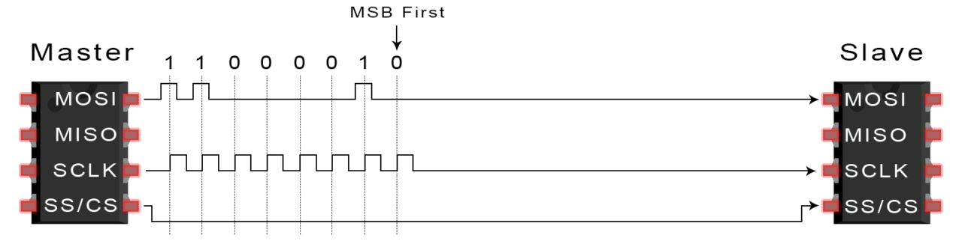
3) The master sends the data one bit at a time to the slave along the MOSI line. The slave reads the bits as they are received

Slide 9
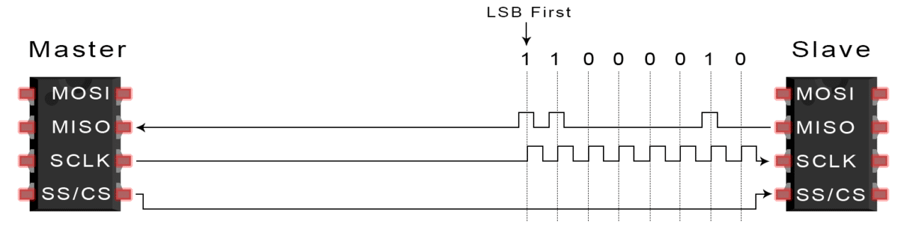
4) If a response is needed, the slave returns data one bit at a time to the master along the MISO line. The master reads the bits as they are received

Slide 10
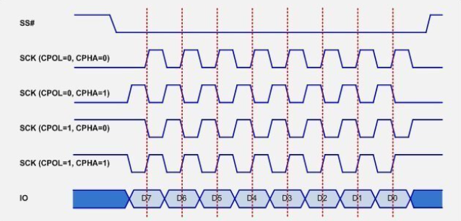
SPI Modes
Mode 0
Mode 1
Mode 2
Mode 3

Slide 11
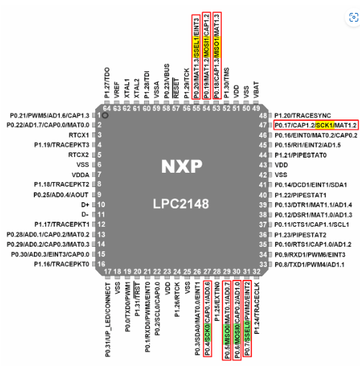
SPI in LPC2148
SPI pins on LPC2148
SPI 1
SPI 0

Slide 12
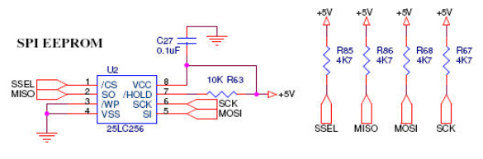
Connection of EEPROM with LPC2148 on ALS kit

Slide 13


SPI registers in LPC2148
Control Register 0
(SSPCR0)
Selects the serial clock rate, bus type, and data size.
Access Type: R/W
Data Size Select
1 0 1 1
1 1 0 0
1 0 1 0
0 1 1 1
1 0 0 0
1 0 0 1
0 1 1 0
0 0 1 1
0 1 0 0
0 1 0 1
This field controls the number of bits transferred in each frame
1 1 0 1
1 1 1 0
1 1 1 1
12 bit transfer
13 bit transfer
11 bit transfer
8 bit transfer
9 bit transfer
10 bit transfer
7 bit transfer
4 bit transfer
5 bit transfer
6 bit transfer
14 bit transfer
15 bit transfer
16 bit transfer

Slide 14

Control Register 0
(SSPCR0)
Frame format
1 1
0 0
1 0
0 1
Not Supported
SPI Frame format
SSI Frame format
Microwire Frame format

Slide 15


Control Register 0
(SSPCR0)
Clock Out Phase
Clock Out Polarity
1
1
0
0
SSP controller maintains the bus clock high between frames
SSP controller captures serial data on the second clock
transition of the frame
SSP controller maintains the bus clock low between frames
SSP controller captures serial data on the first clock transition
of the frame

Slide 16

Control Register 0
(SSPCR0)
Serial Clock Rate
The number of prescaler-output clocks per bit on the bus, minus one. Given that CPSDVR is the prescale divider, and the APB clock PCLK clocks the prescaler, the bit frequency is PCLK / (CPSDVSR * [SCR+1])

Slide 17
Calculation of Serial Clock Rate (SCR)
In this program SCR is calculated for bitrate of 750KHz frequency by considering CPSDVSR = 2 and PCLK as 12Mhz.
Equation to calculate Serial Clock Rate (SCR)
Bitrate = PCLK / ( CPSDVSR * [SCR+1])
Lets consider SCR =X
750K = 12M / ( 2 * [X+1])
( 2 * [X+1]) = 12M / 750K
( 2X ) = 16 -2
( X ) = 14 / 2 = 7

Slide 18
In program SSPCR0 is loaded with 0X707
0 0 0 0 0 1 1 1 0 0 0 0 0 1 1 1
SCR =7 for 750KHz bitrate
8 Bit Transfer
SPI Frame format
SPI Mode 0

Slide 19

Control Register 1 (SSPCR1)
Reserved
Slave Output Disable.
Master/Slave Mode. This bit can only be written when the SSE bit is 0.(SSE)
SSP Enable(SSE)
Loop Back Mode(LBM).
During normal operation
0
This bit is relevant only in slave mode (MS = 1). If it is 1, this blocks this SSP controller from driving the transmit data line (MISO).
0
The SSP controller acts as a master on the bus, driving the SCLK, MOSI, and SSEL lines and receiving the MISO line.
0 The SSP controller is disabled.
The SSP controller will interact with other devices on the serial bus. Software should write the appropriate control information to the other SSP registers and interrupt controller registers, before setting this bit.
1
1
Serial input is taken from the serial output (MOSI or MISO) rather than the serial input pin (MISO or MOSI respectively).
1
The SSP controller acts as a slave on the bus, driving MISO line and receiving SCLK, MOSI, and SSEL line

Slide 20
In program SSPCR1 is loaded with = 0X02
0 0 0 0 0 0 1 0
Normal operation of SPI
SSP Enabled
SSP controller acts as Master on Bus
Relevant only if(MS=1)

Slide 21
SSP Status Register (SSPSR)
Reserved
Receive FIFO Full.(RFF)
Busy(BSY)
Receive FIFO Not Empty.(RNE)
Transmit FIFO Not Full(TNF)
Transmit FIFO Empty. (TFE)
This bit is 1 if the Receive FIFO is full, 0 if not
This bit is 0 if the SSP controller is idle, or 1 if it is currently sending/receiving a frame and/or the Tx FIFO is not empty
This bit is 0 if the Receive FIFO is empty, 1 if not
This bit is 0 if the Tx FIFO is full, 1 if not
This bit is 1 if the Transmit FIFO is empty, 0 if not.

Slide 22
0 0 0 0 0 0 0 1
program waits for the condition 0X01 to say FIFO is empty
0 0 0 0 0 0 1 0
program waits for this condition is 0X10 to be false and it indicates SSP is busy
0 0 0 0 0 1 0 0
program waits for this condition is 0X04 which indicates receive FIFO empty

Slide 23
SSP Interrupt Clear Register (SSPICR)
Reserved
RTIC
RORIC
Writing a 1 to this bit clears the Receive Timeout interrupt.
Writing a 1 to this bit clears the “frame was received when RxFIFO was full” interrupt.

Slide 24
In program SSP Interrupt Clear Register (SSPICR) is loaded with 0X01
0 0 0 0 0 0 0 1
Clears the interrupt

Slide 25
SSP Clock Prescale Register (SSPCPSR)
This even value between 2 and 254, by which PCLK is divided to yield the pre-scaler output clock. Bit 0 always reads as 0.
From Data sheet :
The SSPCPSR value must be properly initialized or else the SSP controller will not be able to transmit data correctly. In case of a SSP operating in the master mode, the CPSDVSRmin = 2. While SSPCPSR and SCR do not affect operations of a SSP controller in the slave mode, the SSP in slave mode can not receive data at clock rate higher than PCLK/12.

Slide 26
Programing EEPROM
Features of EEPROM
EEPROM supports upto MAX clock of 10 MHz
LOW power CMOS technology Max Read current and Write current is 5mA at at 5.5V 10 MhZ
Page size 64 bytes
32,768 by 8 bit organization.

Slide 27
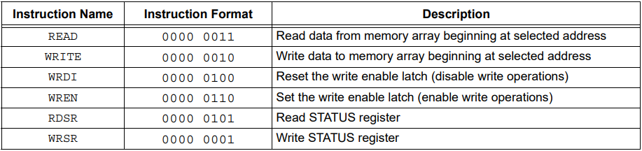
Instruction used for READ and WRITE operation of EEPROM

Slide 28
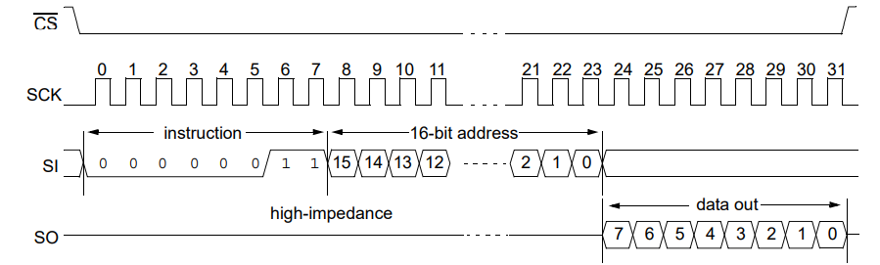
Read Sequence

Slide 29
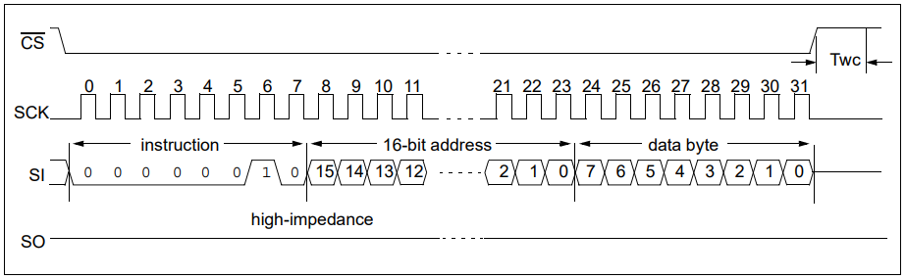
Write Byte Sequence

Slide 30
Procedure to Transmit data between EEPROM and LPC2148 Using SPI protocol
Initialize SPI1 using PCONP with 8 bit transfer ,CPOL and CPHA =0, and SCR =7.
Initialize URAT0 for 9600 baud rate.
Writing EEPROM
Enabling SPI by setting CS line low by loading register IO0CLR with 0X00100000
Wait for transmit FIFO empty by until SSPSR register content = 0X00
Set the write enable latch (enable write operations) by assigning 0X06 to SSPDR
check for SSP controller busy/idle by waiting until SSPSR content change from 0X10 to 0X00 .
Use dummy variable read to clear receive FIFO by assigning SSPDR value to variable dummy
Make CS High by loading register IO0SET with 0X00100000
Wait for transmit FIFO empty by until SSPSR register content = 0X00
Write data to memory array beginning at selected address by assigning 0X02 to SSPDR
check for SSP controller busy/idle by waiting until SSPSR content change from 0X10 to 0X00 .

Slide 31
Use dummy variable read to clear receive FIFO by assigning SSPDR value to variable dummy
Wait for transmit FIFO empty by until SSPSR register content = 0X00
write MSB of address by assigning 0x00 to SSPDR
check for SSP controller busy/idle. by waiting until SSPSR content change from 0X10 to 0X00 .
Use dummy variable read to clear receive FIFO by assigning SSPDR value to variable dummy
Wait for transmit FIFO empty by until SSPSR register content = 0X00
Write LSB of address by assigning 0x00 to SSPDR
checking for SSP controller busy/idle. check for SSP controller busy/idle. by waiting until SSPSR content change from 0X10 to 0X00 .
Use dummy variable read to clear receive FIFO by assigning SSPDR value to variable dummy

Slide 32
Send data to EEPROM by assigning data to SSPDR register
Note: Check for transmit FIFO empty , SSP controller busy/idle and clear SSPDR.
Make CS High by loading register IO0SET with 0X00100000

Slide 33
Reading EEPROM
Enabling SPI by setting CS line low by loading register IO0CLR with 0X00100000
Wait for transmit FIFO empty by until SSPSR register content = 0X00
Read data from memory array beginning at selected address by assigning 0X03 to SSPDR
Check for SSP controller busy/idle by waiting until SSPSR content change from 0X10 to 0X00
Use dummy variable read to clear receive FIFO by assigning SSPDR value to variable dummy
Wait for transmit FIFO empty by until SSPSR register content = 0X00.
write MSB of address by assigning 0x00 to SSPDR
Check for SSP controller busy/idle by waiting until SSPSR content change from 0X10 to 0X00
Use dummy variable read to clear receive FIFO by assigning SSPDR value to variable dummy

Slide 34
Wait for transmit FIFO empty by until SSPSR register content = 0X00
Write LSB of address by assigning 0x00 to SSPDR Check for SSP controller busy/idle.
Use dummy variable read to clear receive FIFO by assigning SSPDR value to variable dummy
Wait for transmit FIFO empty by until SSPSR register content = 0X00
Assign 0X00 to SSPDR
checking for SSP controller busy/idle. check for SSP controller busy/idle. by waiting until SSPSR content change from 0X10 to 0X00 Wait until receive FIFO is empty
Read EEPROM data . By assigning SSPDR value to nvrom_data array.
Disable SPI CS High by loading register IO0SET with 0X00100000

